Slide 1
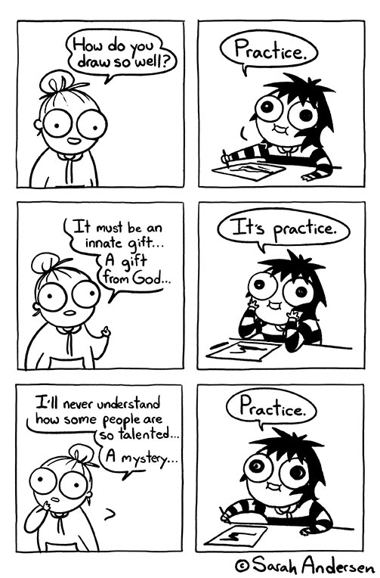
User Interface Design

Slide 2
UI Design: Friday Sept 2 (Day 6)
Dr. Jillian Aurisano
Plan for today:
Announcements/Course logistics
Project
Sketching review
Sketching an interface
The Vanilla Sketch
The Digital Sketch
Whiteboard sketch
The sticky-note sketch
Sketching with a template
Sketching activity
Notes:
So welcome to engineering visual interfaces for data science. I'm Dr Aurisano.
Thanks for finding the class on Zoom. Hopefully we will be in person again soon.
If anyone out there is comfortable turning on their cameras, that is lovely- then I feel like I am talking to students, rather than to myself.
Here’s our plan for today:
First I’m going to introduce myself, so you know a bit about me
Then we are going to get to know each other, in Zoom breakout rooms. This will give us a chance to make sure that Zoom breakout rooms work, and we all know how to access them.
Then, I am going to walk through the structure, and plan for the course. I want to make sure everyone knows how the course will work, and what to expect, and also a bit about why the course is designed this way.
Then I am going to introduce the class, and what the class is about. Since this is a new class, and one of just a few classes in human centered computing here at UC, I wanted to give an overview of the topic.
Then I have an introductory activity, which we will do in breakout rooms, and which I think will help motivate the discussion on Wednesday, and getting into the meat of the class.

Slide 3
Announcements / Course logistics
Sketching activities today and Friday
SAVE YOUR SKETCHES!
Turn in at link to be posted on Canvas
I am going to post some example responses to the 10-plus-10 example we did, but I want to let you do this on your own first.
Project: It is posted- let’s walk through it.

Slide 4
So we have found a need, a design goal
People want to be able to exchange photos easily with someone who is nearby
They don’t want to go through a complex authentication protocol to connect to the other phone
We did it through interviews, but other ways….

Slide 5
We creatively brainstormed ways to address that goal (10-plus-10 method)
They open the app and then….
Maybe they write the same keyword
Maybe they do a phone handshake
Maybe they use the flashlight somehow
Maybe they draw a picture together
Maybe they put their phones together and play a game
Maybe they play a song and the other phone recognizes the song
….

Slide 6
We pick one, and dive deeper
Elaborate
Walk through it step by step
Discuss alternatives
Example:
Ok, phone handshake
phones tap a. in the front, b. in the back, c. at the sides?
Phone shake up and down without tapping?
….
Get closer to a design we want to execute

Slide 7
But wait….
I just wrote those ideas in words
Why did we need to sketch them?
Sometimes we start with a label for the concept but….
Sketching gets us closer to realizing this concept with a visual design
Sketching helps us identify problems with our concept
Oh I didn’t think about how this would work…

Slide 8
What’s next?
How would I actually create this design, implement this interface?
Sketching an interface prototype
First one- can be VERY sketchy
Get iteratively more concrete
Critique your design and feedback as you go

Slide 9
Ways to “sketch” interface prototypes
The Vanilla sketch
The Digital Sketch
The Sticky-note sketch
Sketching with a template
Photo traces
Hybrid sketches
Physical mock-ups
All of the above- starting with sketching the interface at one moment in time

Slide 10
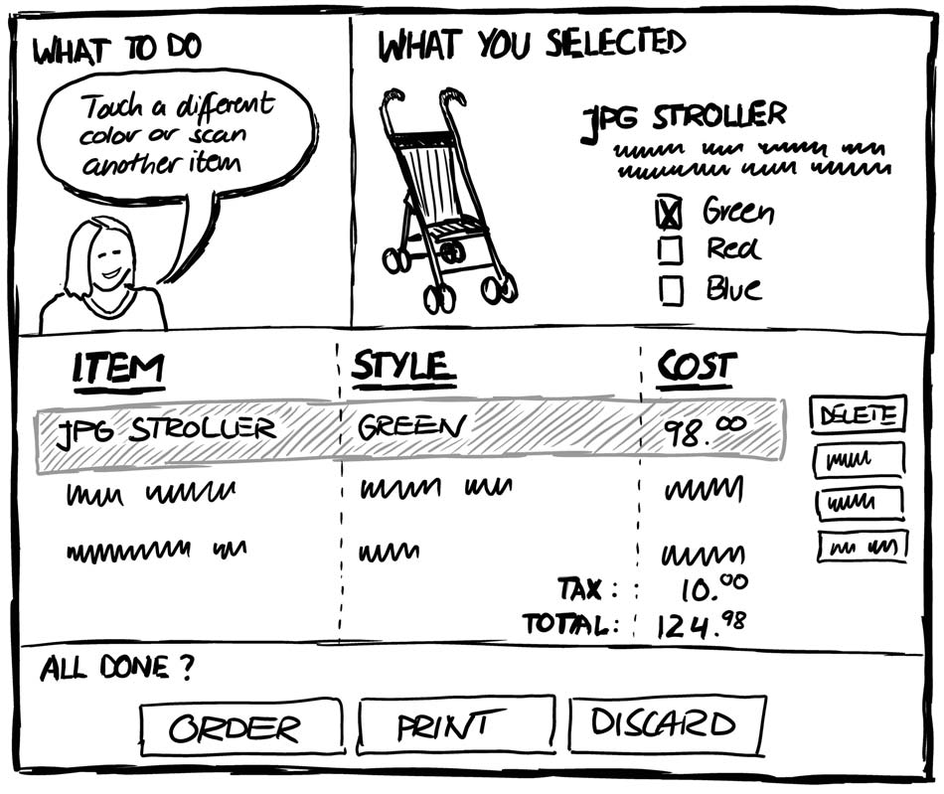
The Vanilla sketch
What most people think of as a sketch
Example- suppose you have a shopping app
Want to prototype the tool and layout
What do we notice about this sketch?

Slide 11
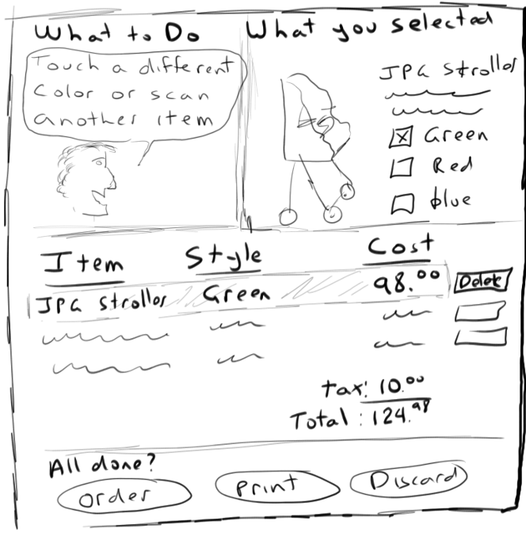

The Vanilla sketch- from low to high fidelity

Slide 12
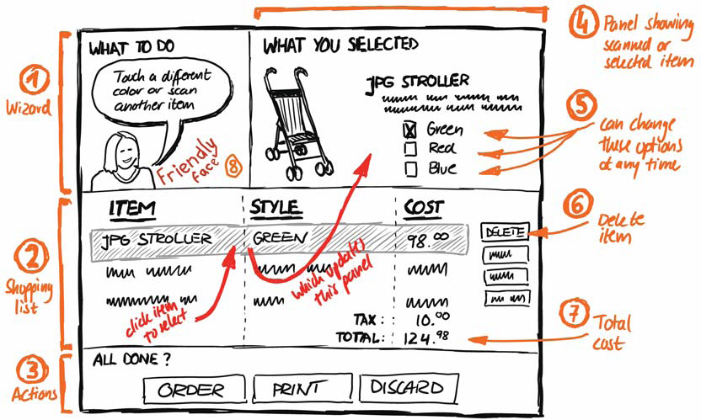
Tools for a Vanilla sketch: Annotations
You don’t just have to show the interface

Slide 13
Annotation tips:
Labels
Explanatory notes
Location of annotation correlates with region of the UI we are commenting on
Example
proximity to area
braces for large areas
arrow to specific area

Slide 14
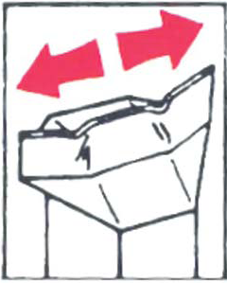
Arrows as Annotation
Can also
emphasise area of interest
relate different parts of a sketch
indicate direction
show movement
indicate a sequence of events (interaction flow)

Slide 15
Arrows as Annotation
Although we are sketching a moment in time, we can convey causality, or the relationship between parts of the UI with annotations such as arrows and explanatory labels

Slide 16
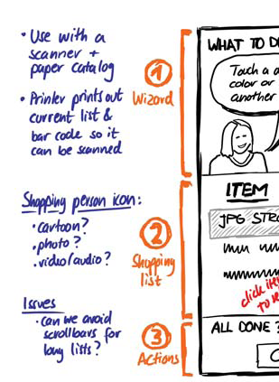
Notes
ideas about design elements left out of the drawing
alternate design options of sketch elements
design issues

Slide 17
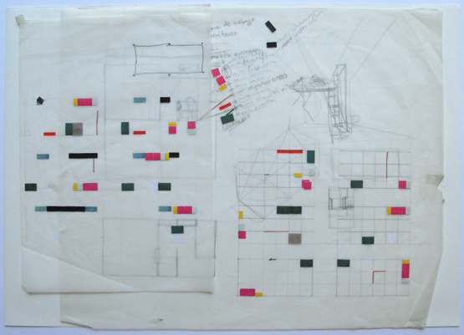
Annotations and notes
Can be drawn directly on the sketch
Or added as a layer
Tracing paper
Or digital layer
Image from http://www.shop.casaleganitos.com/silk-screens/architecture-drawings/

Slide 18
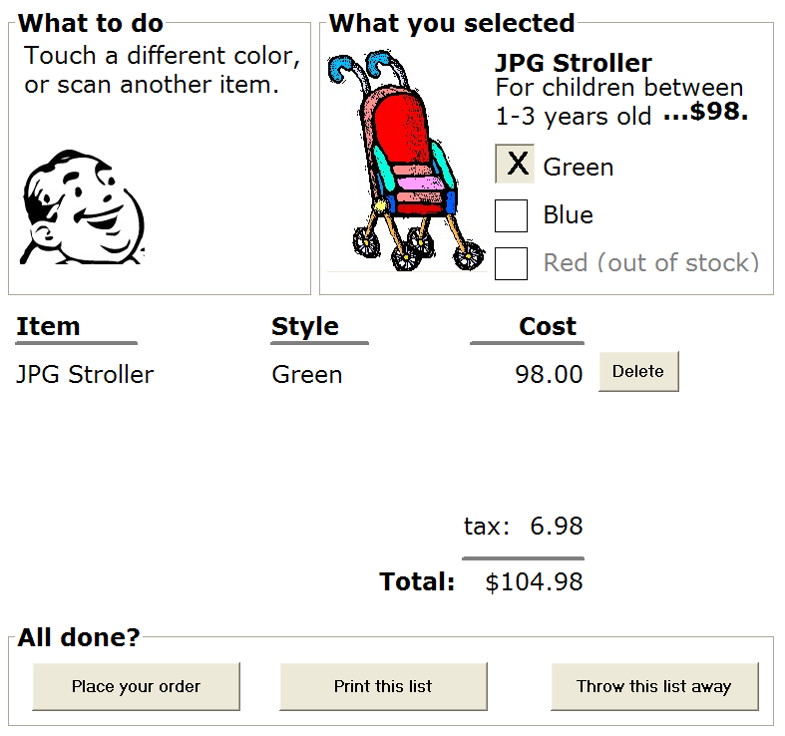
The digital sketch
Can use a drawing tool to create a digital sketch
re-usable,
editable,
closer to the ‘real thing’
Takes a bit more time, but it can be copied, edited…
Trade-offs

Slide 19
Power point- great option for digital sketching
You don’t need a fancy tool to make digital sketches
Easy to share, give to others to edit

Slide 20
But there are tools out there…
Omnigraffle is my favorite (mac only)
Adobe tools
Any others you use ….?

Slide 21
Which has more openness?
Sketchy sketches leave room for the imagination and creativity
Indicate an openness to change
Make it easier to capture feedback

Slide 22
Value of openness, blanks, vague rendering
Example: Friend working with nurses, shows a non-sketchy sketch,
They discuss the size of the text, or the color schemes
They don’t brainstorm ideas for what to fill in the sketchy parts
They don’t comment on the functionality
He doesn’t get what he needs from his discussions with them

Slide 23
But- the ability to edit, reuse, is valuable!
- Is there something in between a sketchy and a digital sketch?

Slide 24
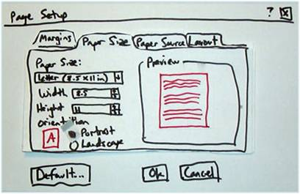
Whiteboards
Easier to erase
Nice for collaborative brainstorming - Multiple people can sketch
Photo to save the sketch

Slide 25
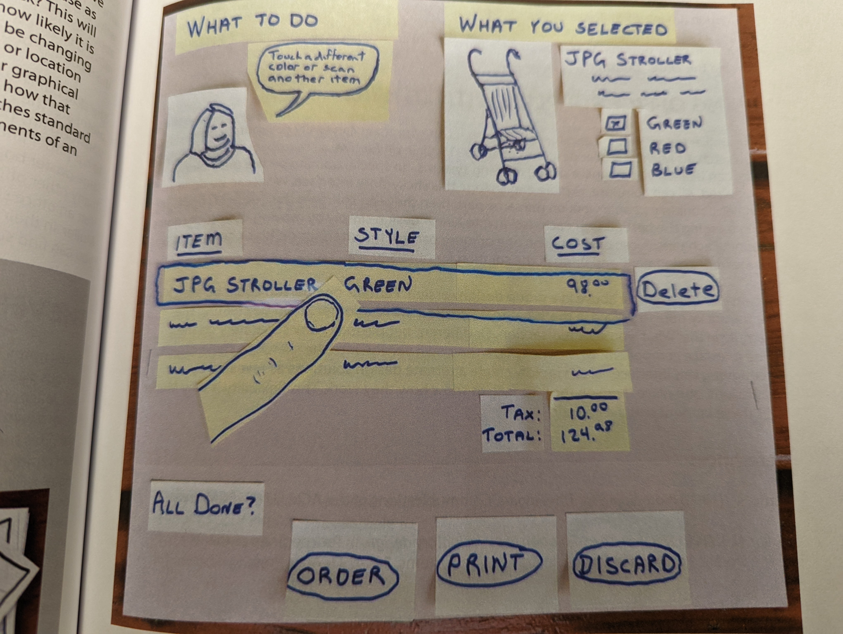
Sticky note sketch
Takes somewhat longer than a vanilla sketch
BUT- you can edit
Replace one sticky note with another
Move them around
Can do both regular sketch and sticky note
What may change?
What may I want to move?
Example from Sketching user experiences book

Slide 26
Sticky note sketch
Example from Sketching user experiences book
Interesting ideas:
Sticky note Finger with a clear acetate paper highlight
Can move the finger around, and change the selection
Add in new sticky notes to see what happens next
Photograph, to save
Could have your user ‘interact’ , you stand in for the interactive updates with sticky notes

Slide 27
Sticky notes + whiteboards + office supplies
Go for it!

Slide 28
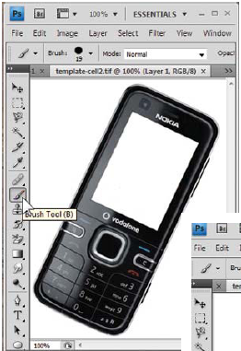
Templates
Sometimes you are ONLY changing one portion of the design
Can keep the preserved part with a reusable template

Slide 29
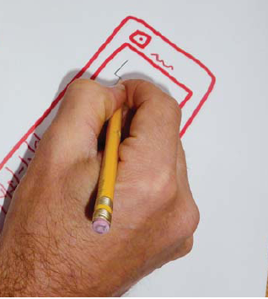
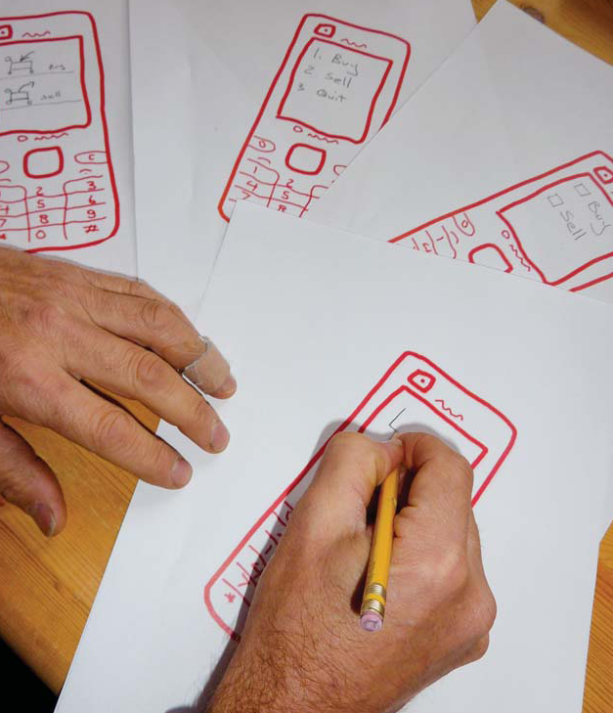
Sketching a template
Sketch and photocopy

Slide 30
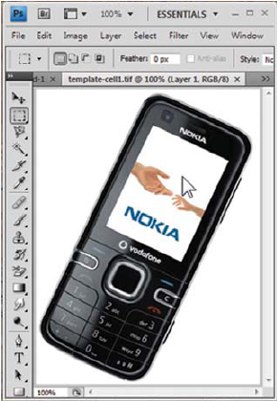
Digital template and print

Slide 31
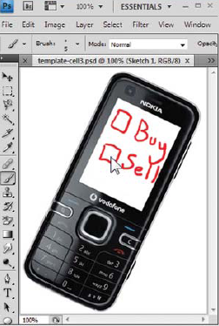
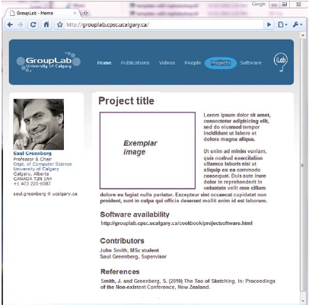
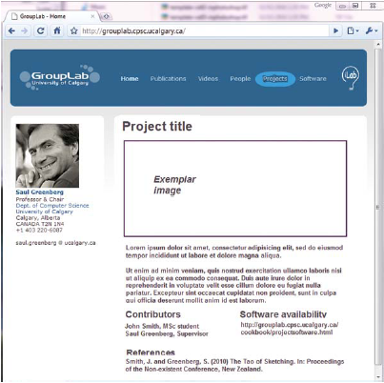
But, better if template + sketch fidelity match

Slide 32
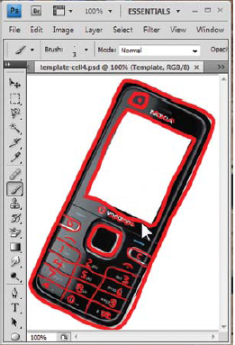
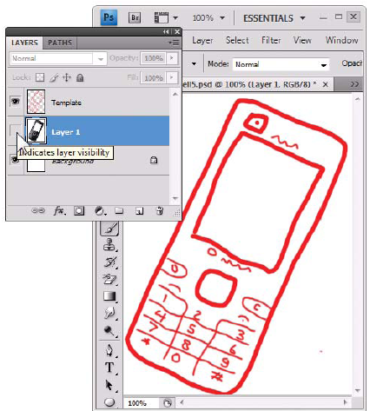
Tracing, and they printing
If it is hard to draw a phone template free-hand, you can trace
Trace digitally

Slide 33
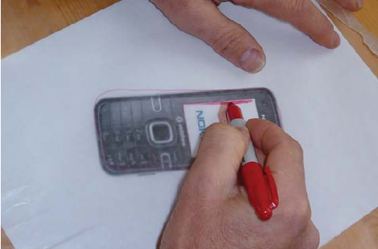
Print, trace, scan, print
Clear acetate paper

Slide 34
Let’s practice!
Canvas activity
Suppose we have opened the photo sharing app
Draw two alternate versions of an interface for selecting the photos you want to share
One moment in time- can use annotations to suggest actions and causality
Suppose the users then do the authentication – like they bump the phones together, authentication success
Draw two alternate versions of an interface for accepting the photos on the other user’s phone

